Slide 2
Native iOS, Android, and Windows apps in C#
James Montemagno
Xamarin

Slide 3
What is Native?
Notes:
What makes up a “Native” mobile application? I am sure you have heard the “native” thrown around, but what does that really mean?

Slide 4
Native User Interfaces
Native API Access
Native Performance
Notes:
A native app needs a lot of things, but three important ones stick out:
Native User Interface: Apps need to look and act correct per platform.
Full SDK Access: As a developer we need to add the latest and greatest features
Native Performance: Needs to be fast and fluid

Slide 5
Architecting Mobile Apps
Notes:
So we know what we want how do we get there? Let’s talk about the state of mobile development.

Slide 6
Silo Approach
Objective-C
in
Xcode
Java
in
Android Studio
C#
in
Visual Studio
No shared code • Many languages & development environments • Multiple teams
Notes:
Multiple Teams
Multiple Code Bases
Expensive & Slow
Positive = Great apps delivered to user’s platform
Negative = Development hampered by multiple code bases & fragmentation

Slide 7
Write Once, Run Anywhere
Lua
Javascript
Actionscript
HTML+CSS
App Generator
Limited native API access • Slow performance • Poor user experience
Notes:
Unhappy Users
Unhappy Developers
Increase in Abandoned Apps
Limited to what is implemented

Slide 8
Xamarin’s Unique Approach
iOS-specific C#
Android-specific C#
Windows-specific C#
Shared C# Logic
Shared C# codebase • 100% native API access • High performance

Slide 9
Windows APIs
Microsoft.Phone
Microsoft.Networking
Windows.Storage
Windows.Foundation
Microsoft.Devices
System.Net
System
System.IO
System.Linq
System.Xml
System.Data
System.Windows
System.Numerics
System.Core
System.ServiceModel

Slide 10
iOS – 100% API Coverage
MapKit
UIKit
iBeacon
CoreGraphics
CoreMotion
System.Net
System
System.IO
System.Linq
System.Xml
System.Data
System.Windows
System.Numerics
System.Core
System.ServiceModel

Slide 11
Android – 100% API Coverage
Text-to-speech
ActionBar
Printing Framework
Renderscript
NFC
System.Net
System
System.IO
System.Linq
System.Xml
System.Data
System.Windows
System.Numerics
System.Core
System.ServiceModel

Slide 12
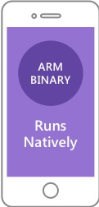
Native Performance
AOT
.APP
Xamarin.iOS does full Ahead Of Time (AOT) compilation to produce an ARM binary for Apple’s App Store.
Xamarin.Android takes advantage of Just In Time (JIT) compilation on the Android device.

Slide 13
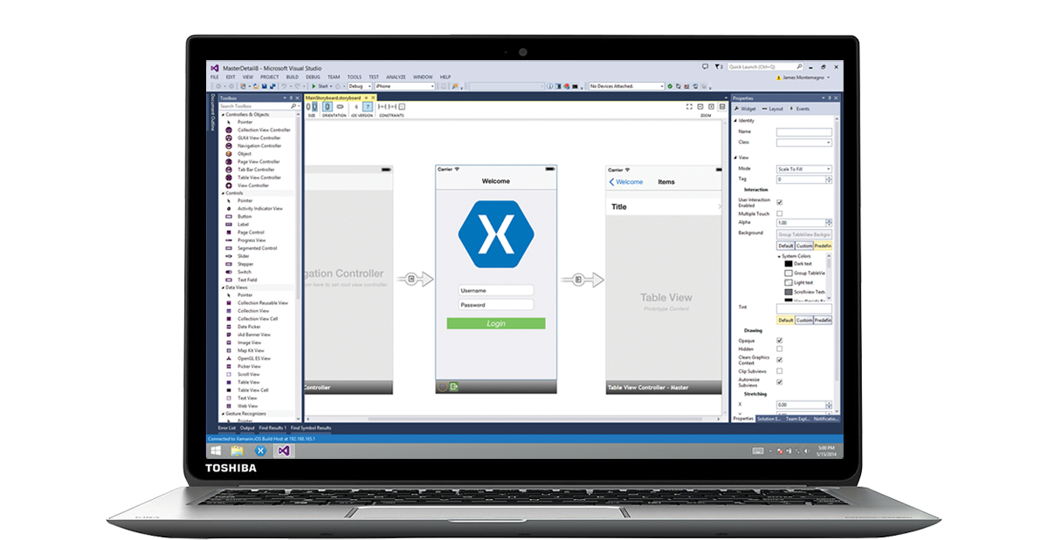

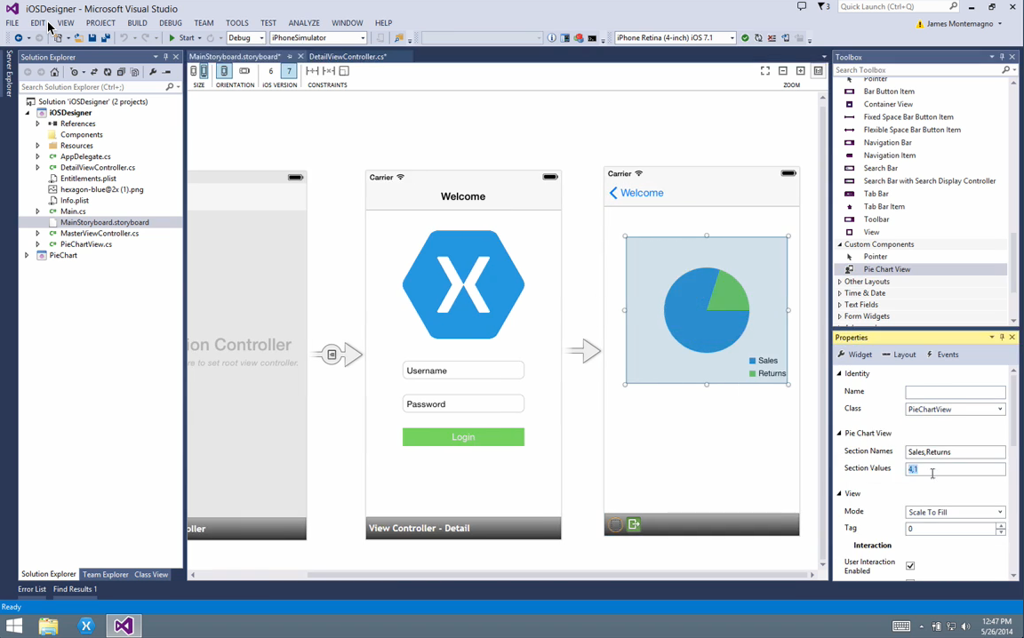
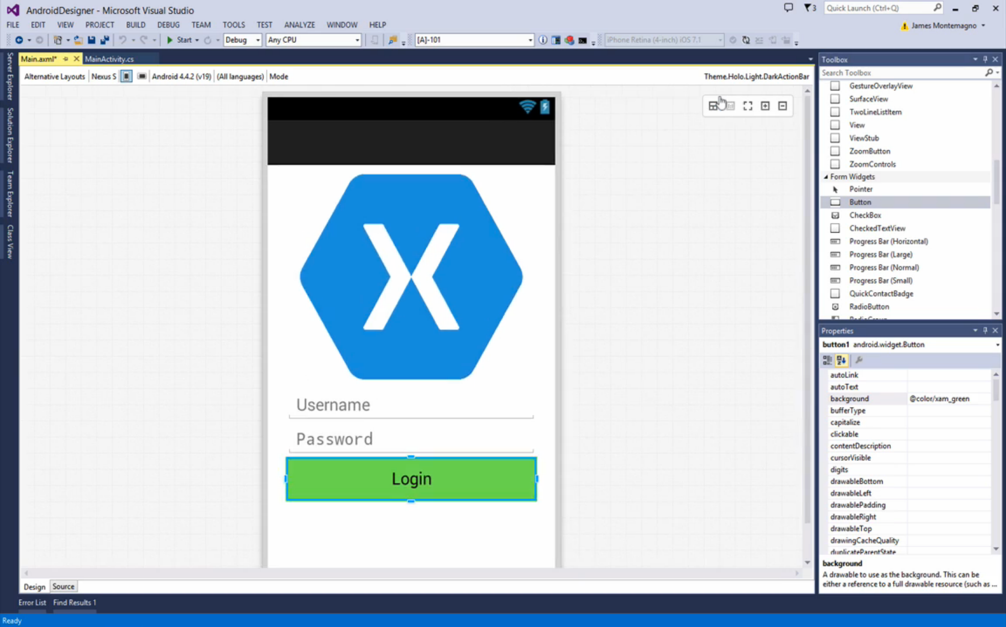
Visual Studio Integration

Slide 14
✓Always Up-to-Date
Same-day support:
iOS 5
iOS 6
iOS 7iOS 8
iOS 9
Full support for:
Apple Watch
Apple TV
Android Wear
Amazon Fire TV
and much more
Notes:
Apple has a developer preview where Xamarin has alphas ready. Google does not offer this.
Android versions are usually 4 to 8 weeks out for a stable release, but alphas and betas are usually earlier.
Xamarin realizes how important having iOS ready because within 24 hours a large portion of iOS users upgrade
Android on the other hand is much different. After 4 months on the market Android 4.4 only had 1% adoption

Slide 15
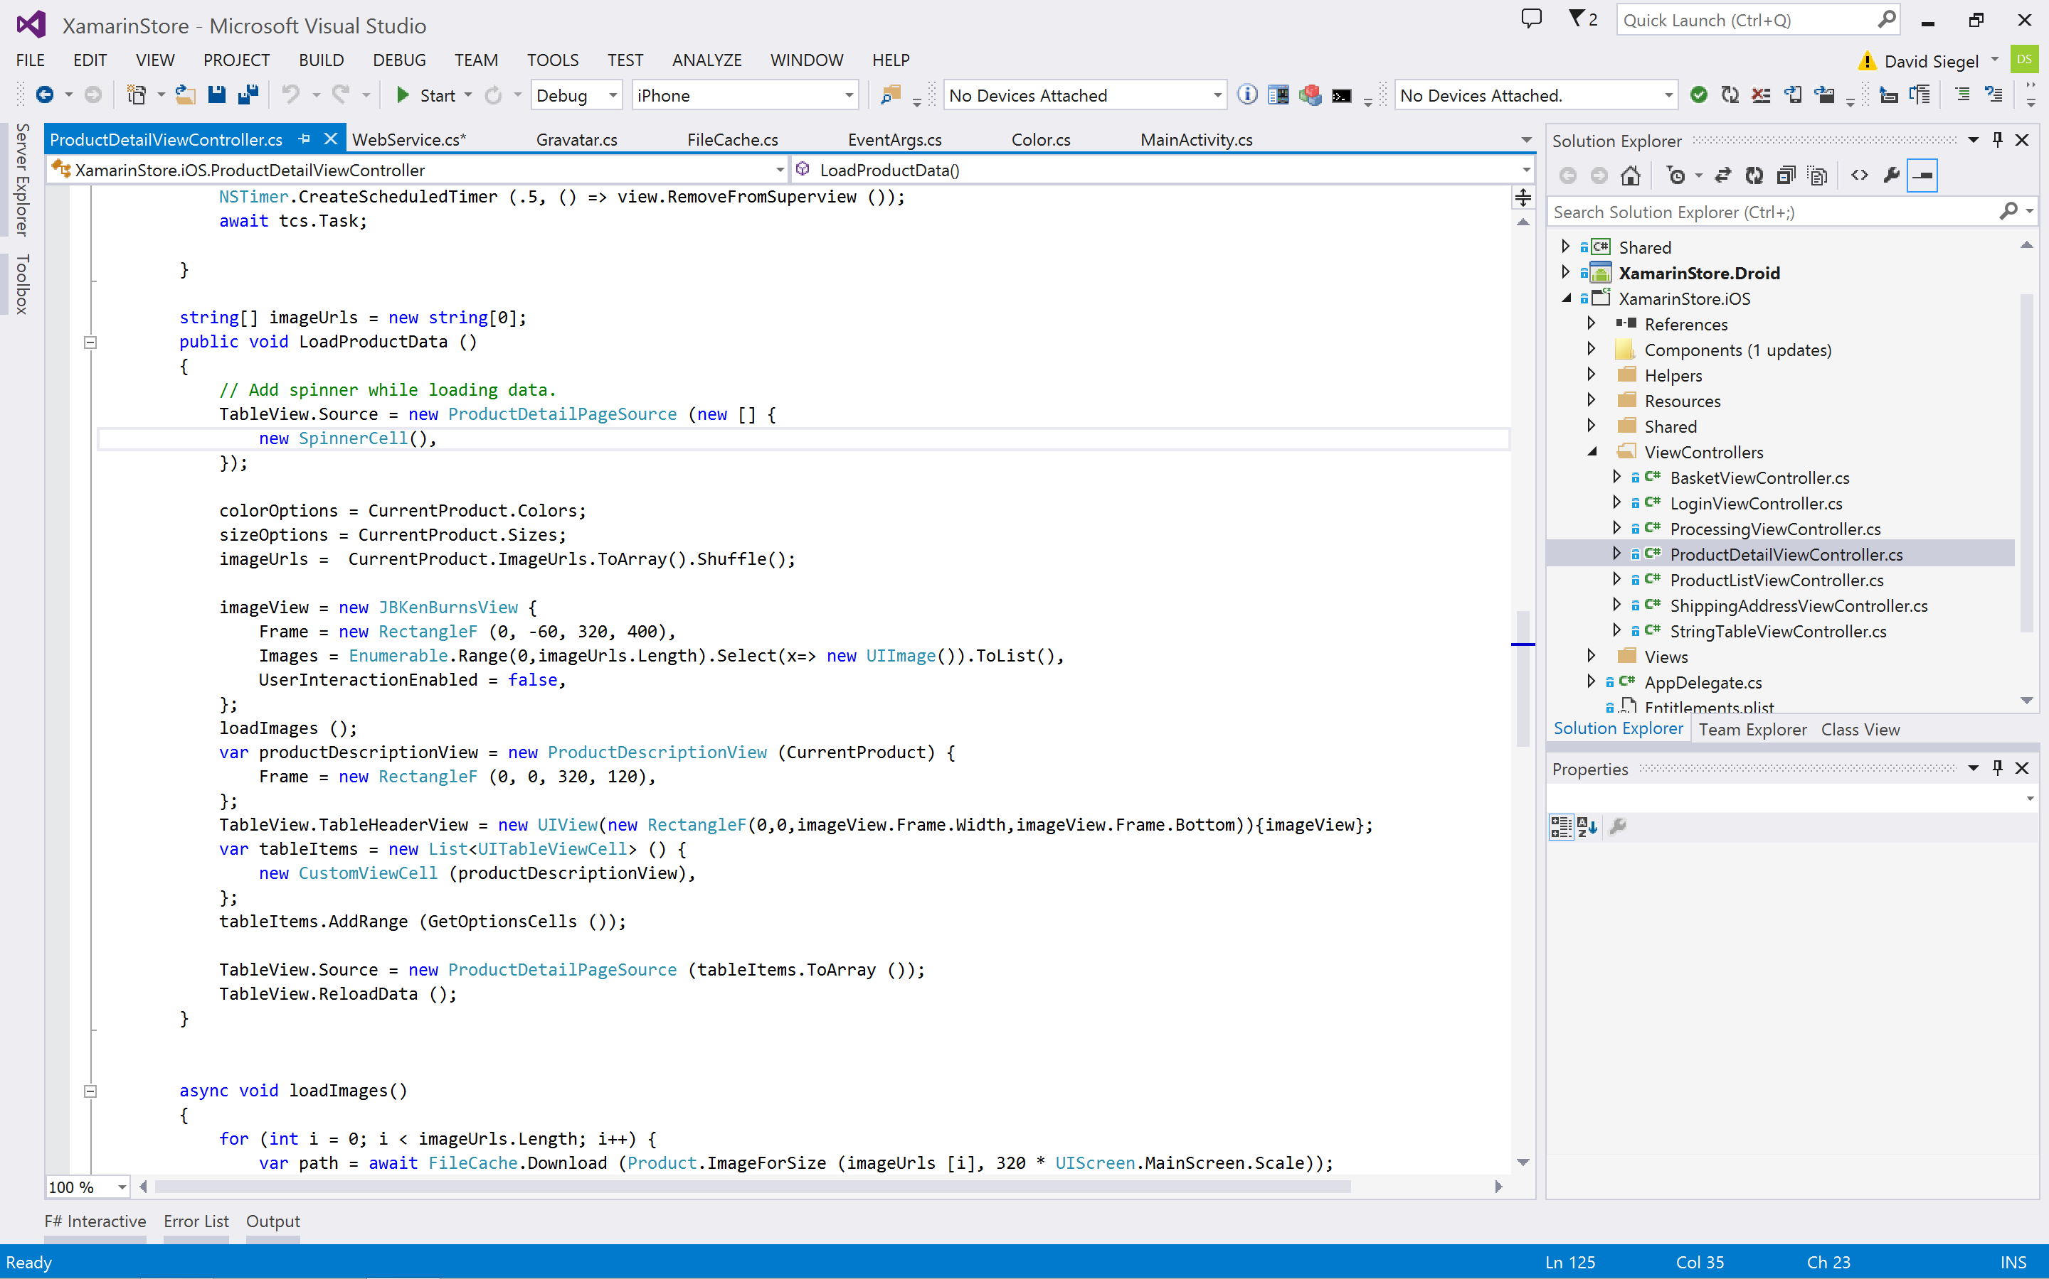
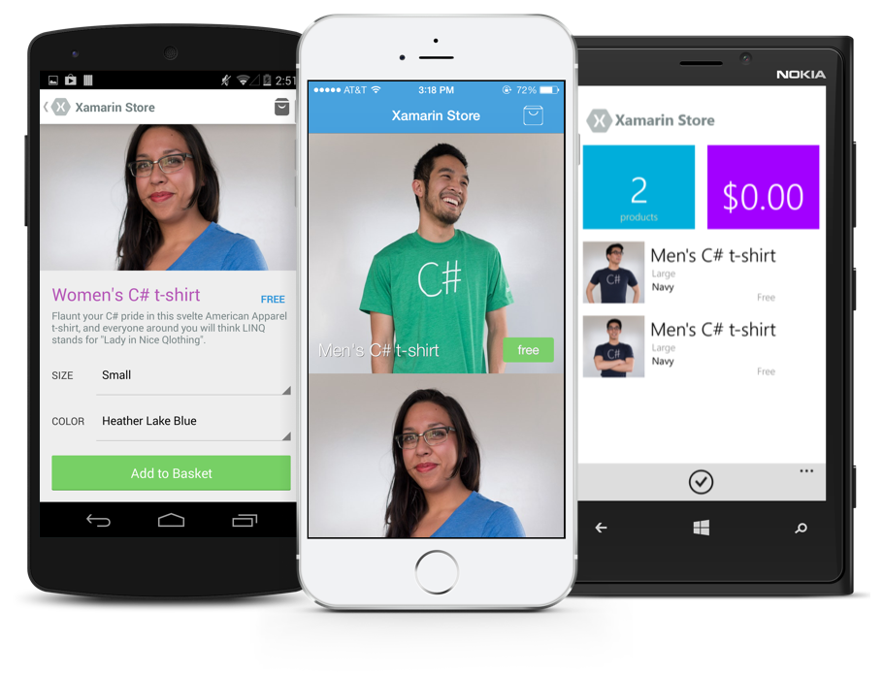
Anything you can do in Objective-C, Swift, or Java can be done in C# and Visual Studio with Xamarin.
Notes:
Coming up next is bubbles

Slide 16
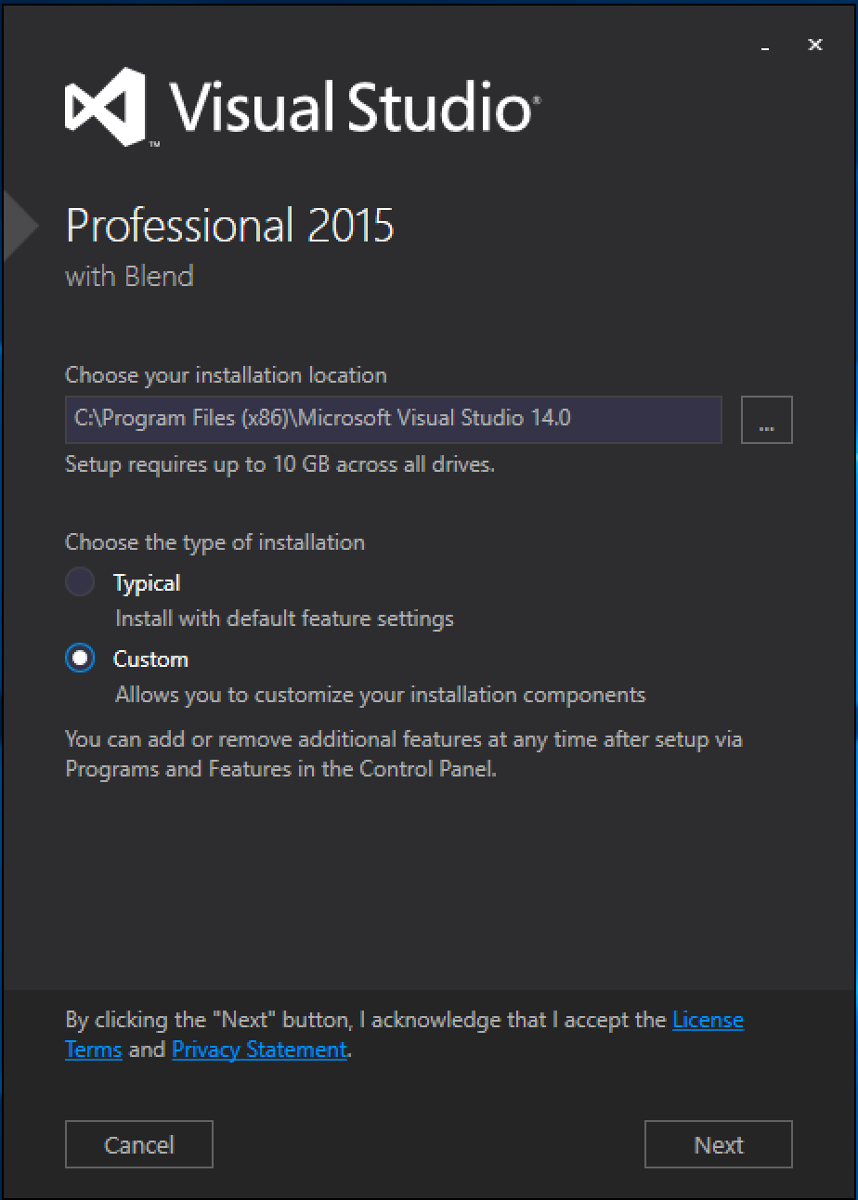
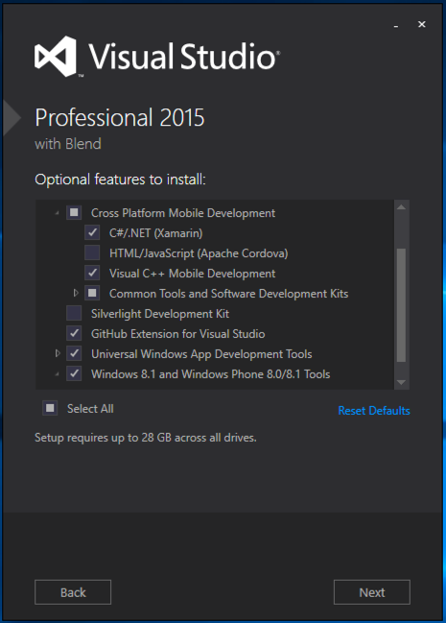
Visual Studio Integration
Xamarin.com/Download

Slide 17
Sharing Code

Slide 18
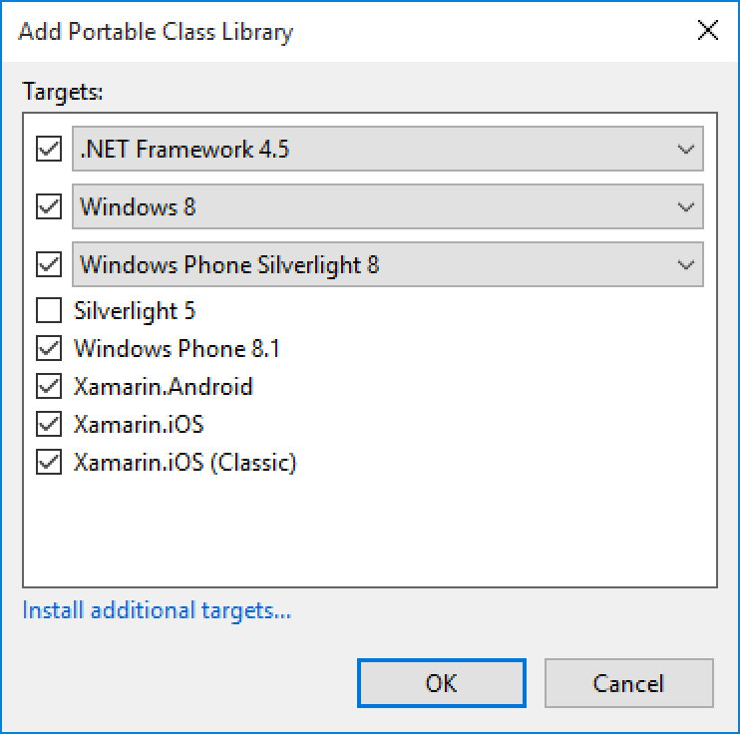
Portable Class Libraries
1 Assembly
Multiple Platforms
Including:
Xamarin.iOS and Xamarin.Android

Slide 19
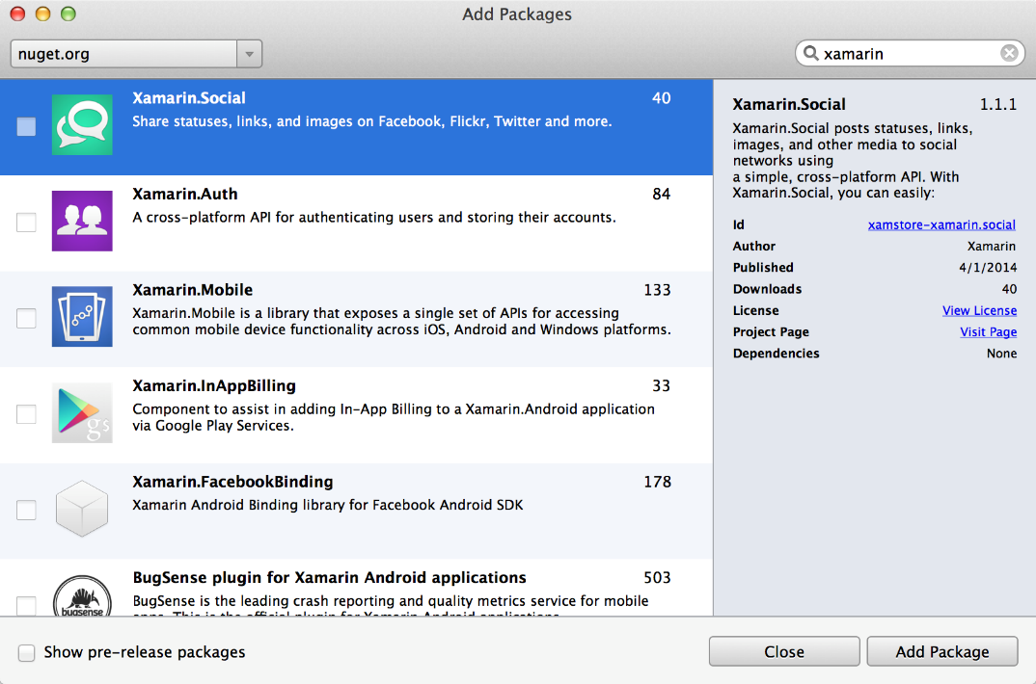
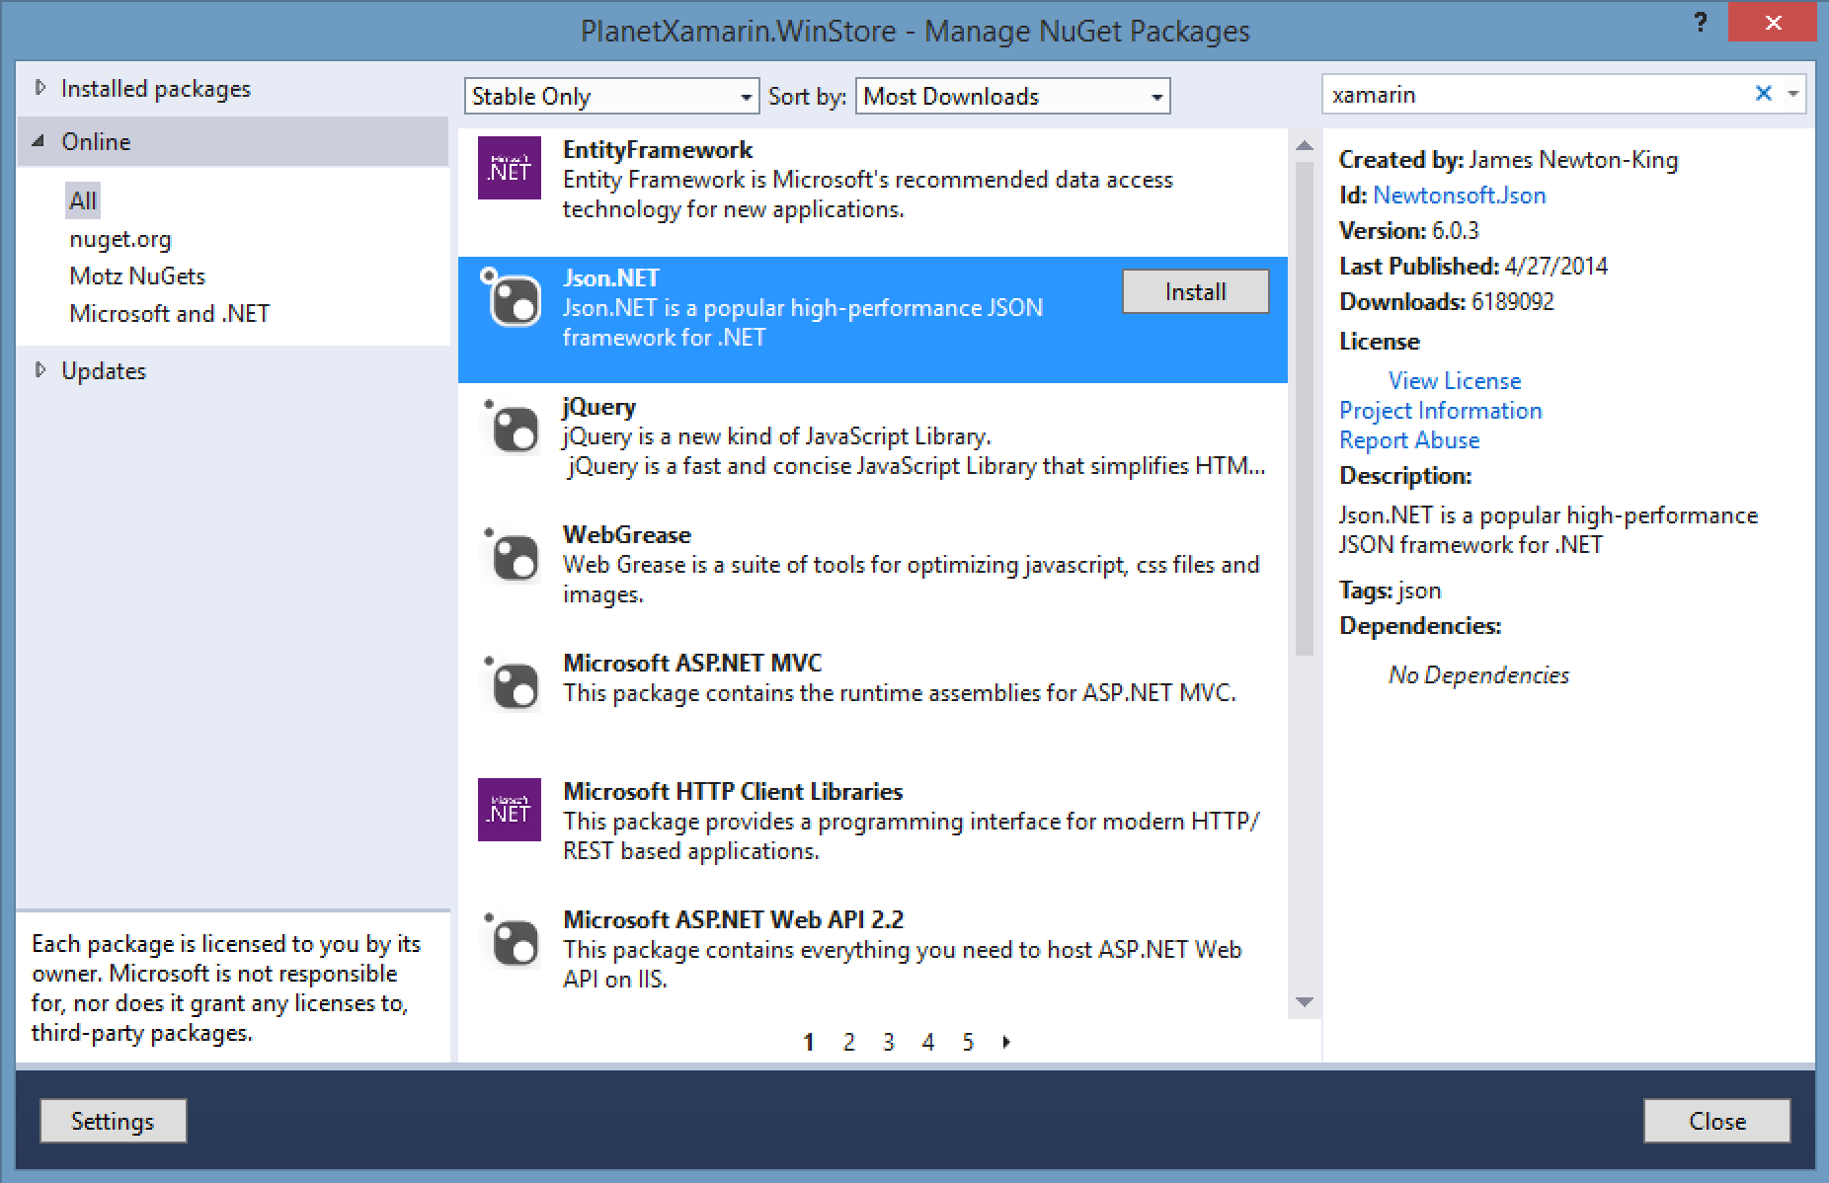
NuGet
Notes:
Use all of your favorite libraries from NuGet or share and distribute your own!

Slide 20
Code Sharing Stats
iCircuit
Touch Draw
Android
iOS
Mac
Windows Phone
Notes:
iCircuit is made by Frank Krueger, a long time Mono & Xamarin developer.
Sharing code lead to 70 to 90% code reuse across platforms speeding up development
Real-time circuit simulator and editor used to design analog and digital circuits
http://praeclarum.org/post/42378027611/icircuit-code-reuse-part-cinq

Slide 21
Let’s take a look!

Slide 22
Shared C# Logic

Slide 23
Platform Specific Code
UI + APIs
Battery
GPS
Lights
Notifications
Settings
Text to Speech
UI + APIs
Battery
GPS
Lights
Notifications
Settings
Text to Speech
UI + APIs
Battery
GPS
Lights
Notifications
Settings
Text to Speech
What if we didn’t have to write this code?
What if we could access it from shared code?

Slide 24
Speak (“Hello World”);
AVSpeechSynthesizer
TextToSpeech
SpeechSynthesizer

Slide 25
Plugins for Xamarin
xamarin.com/plugins
Common API

Slide 26
Let’s use a plugin!

Slide 27
Get Started Today
Xamarin.com

Slide 28
Resources
Code:
http://github.com/jamesmontemagno/CoffeeFinder
https://github.com/Azure-Samples/MyDriving
Get Started:
http://xamarin.com
Follow me:
GitHub: JamesMontemagno
Twitter: @JamesMontemagno

Slide 29
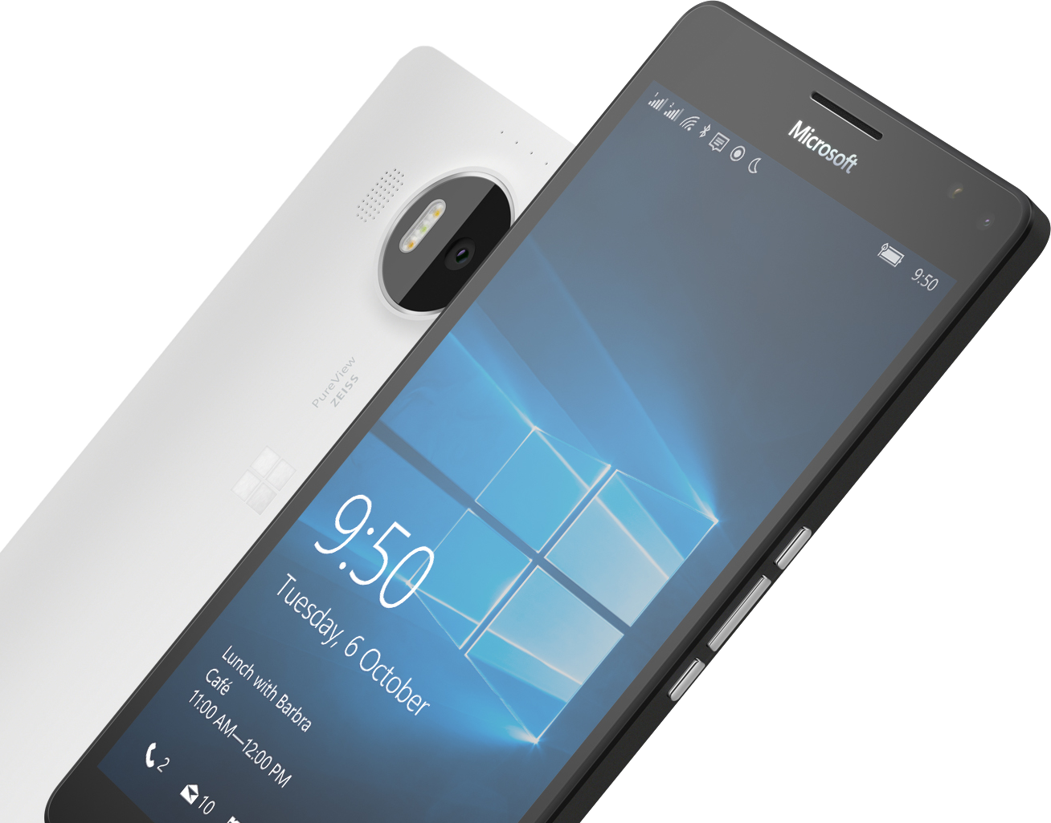
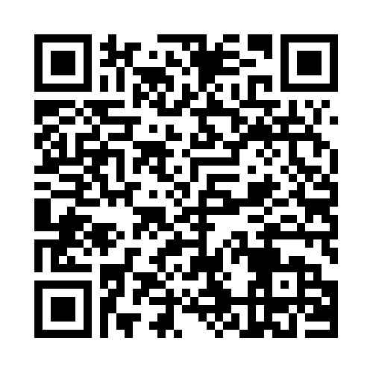

Please Complete An Evaluation Form Your input is important!
Required Slide
*delete this box when your slide is finalized
SAMPLE
or
Notes:
Update phone image to a Microsoft phone.

Slide 30
Evaluate this session
Required Slide
*delete this box when your slide is finalized
Speakers: This slide will be updated during the scrub process with a unique QR code. Attendees scan the QR code to access the eval for your session.
SAMPLE
Notes:
Speakers: Please note this slide will be updated with your session’s QR code during the scrub process which is outlined on side 3. Attendees can scan the QR code for access to your session’s eval.

Slide 31
Notes:
Dark gray background.

